Slide 1
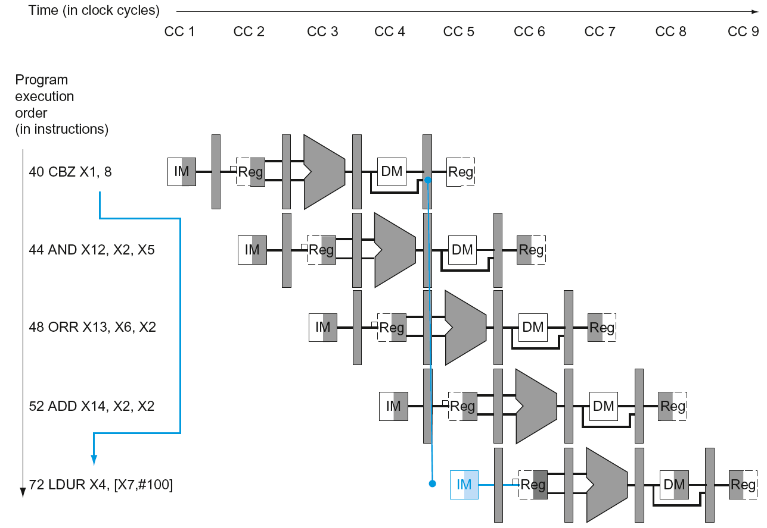
Branch Hazards
§4.8 Control Hazards
If branch outcome determined in MEM
Flush these
instructions
(Set control
values to 0)
PC
Chapter 4 — The Processor — <number>
Notes:
Morgan Kaufmann Publishers
Chapter 4 — The Processor

Slide 2
Reducing Branch Delay
Move hardware to determine outcome to ID stage
  Target address adder
  Register comparator
Example: branch taken
  36: SUB X10, X4, X8
  40: CBZ X1, X3, 8
  44: AND X12, X2, X5
  48: ORR X13, X2, X6
  52: ADD X14, X4, X2
  56: SUB X15, X6, X7
  ...
  72: LDUR X4, [X7,#50]
Chapter 4 — The Processor — <number>
Notes:
Morgan Kaufmann Publishers
Chapter 4 — The Processor

Slide 3
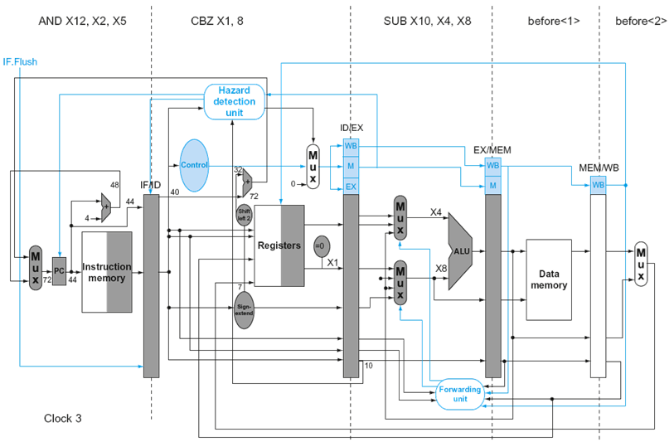
Example: Branch Taken
Chapter 4 — The Processor — <number>
Notes:
Morgan Kaufmann Publishers
Chapter 4 — The Processor

Slide 4
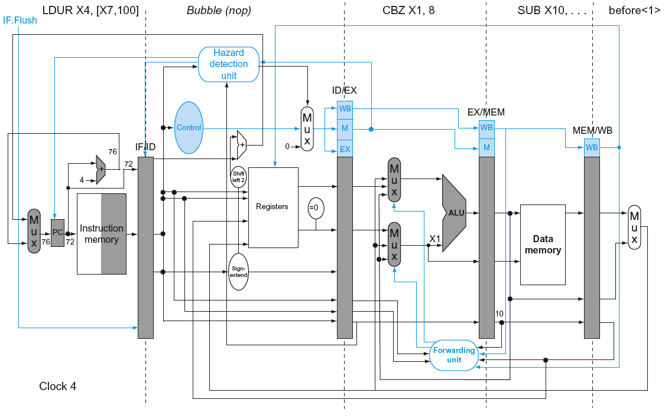
Example: Branch Taken
Chapter 4 — The Processor — <number>
Notes:
Morgan Kaufmann Publishers
Chapter 4 — The Processor

Slide 5
Dynamic Branch Prediction
In deeper and superscalar pipelines, branch penalty is more significant
Use dynamic prediction
  Branch prediction buffer (aka branch history table)
  Indexed by recent branch instruction addresses
  Stores outcome (taken/not taken)
  To execute a branch
    Check table, expect the same outcome
    Start fetching from fall-through or target
    If wrong, flush pipeline and flip prediction
Chapter 4 — The Processor — <number>
Notes:
Morgan Kaufmann Publishers
Chapter 4 — The Processor

Slide 6
Bimodal Dynamic Branch Predictor
The behavior of most branches is not random – they are either usually taken or usually not taken
Bimodal predictors take advantage from this bimodal distribution by distinguishing usually taken from usually not taken branches
Predictor is implemented as a table of counters indexed by the low-order address bits in the program counter.
Each counter is two-bits long (we will see why shortly)

Slide 7
Bimodal Branch Predictor
Prediction counters
Prediction
(T/NT)
PC
How many bits are needed for the counters?

Slide 8
1-Bit Predictor: Shortcoming
Inner loop branches mispredicted twice!
outer: …
…
inner: …
…
CBZ …, …, inner
…
CBZ …, …, outer
  Mispredict as taken on last iteration of inner loop
  Then mispredict as not taken on first iteration of inner loop next time around
Chapter 4 — The Processor — <number>
Notes:
Morgan Kaufmann Publishers
Chapter 4 — The Processor

Slide 9
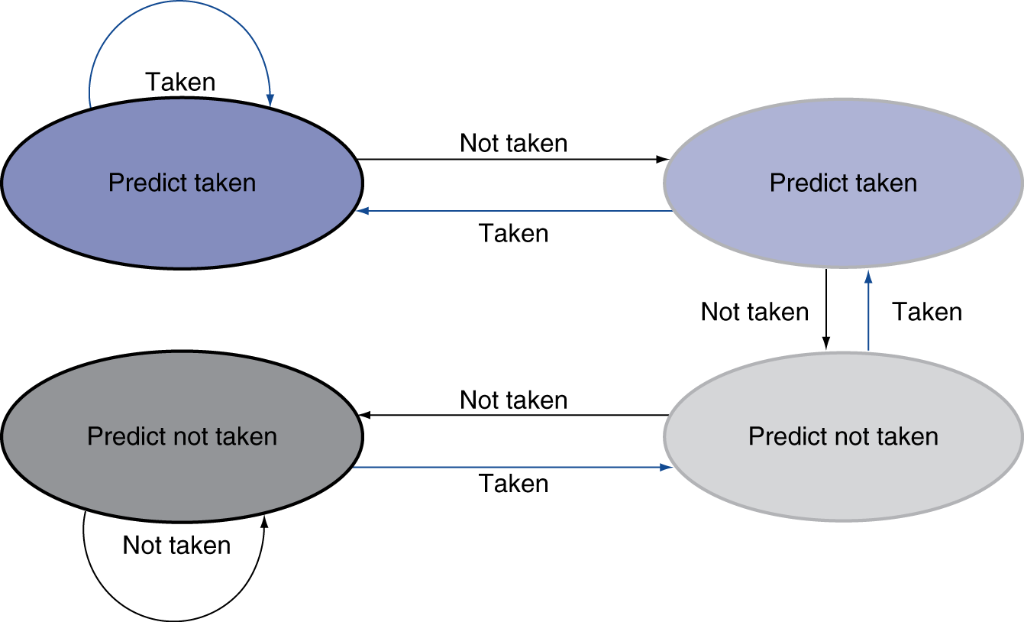
2-Bit Predictor
Only change prediction on two successive mispredictions
Chapter 4 — The Processor — <number>
Notes:
Morgan Kaufmann Publishers
Chapter 4 — The Processor

Slide 10
When is Branch Predictor Accessed?
Fetch
Decode
Execute
Memory
WB
Lookup
Predictor
Update

Slide 11
Calculating the Branch Target
Even with predictor, still need to calculate the target address
  1-cycle penalty for a taken branch
Branch target buffer
  Cache of target addresses
  Indexed by PC when instruction fetched
    If hit and instruction is branch predicted taken, can fetch target immediately
Chapter 4 — The Processor — <number>
Notes:
Morgan Kaufmann Publishers
Chapter 4 — The Processor

Slide 12
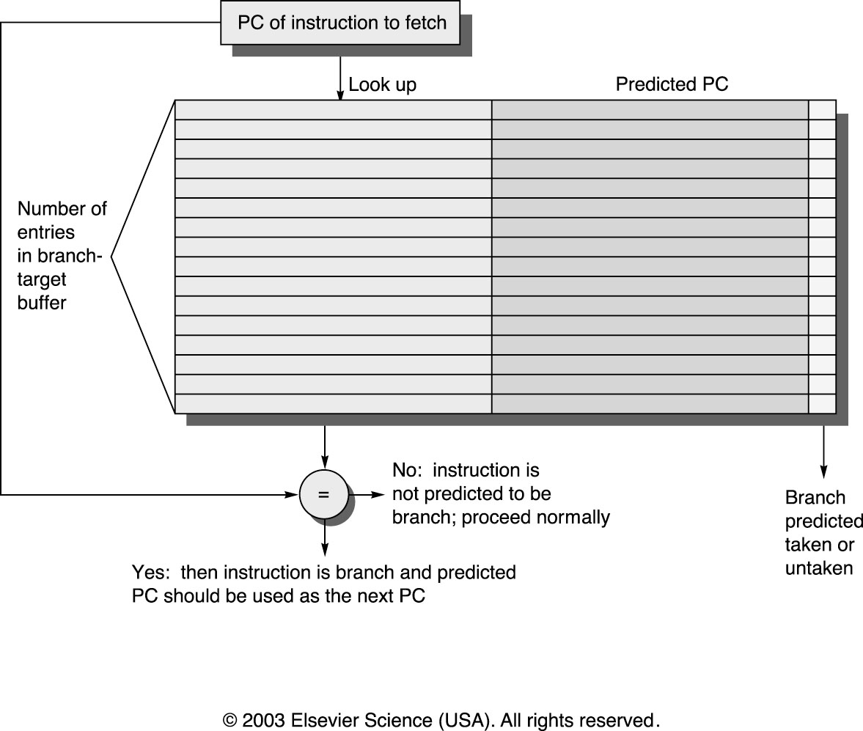
Branch Target Buffers

Slide 13
Next step: Exploiting Branch Correlation
B1: if (x)
...
B2: if (y)
...
z=x&&y
B3: if (z)
...
B3 can be predicted with 100% accuracy based on the outcomes of B1 and B2

Slide 14
Two-level prediction based on global history
A single shift register (GR) is used to record the direction taken by most recent n conditional branches
Helps when direction taken by a branch strongly depends on the outcomes of other branches
If(x<1)…
If(x>1)…
Using global history, it is possible to base the prediction for the second if on the direction taken by the first if

Slide 15
Correlating Branch Predictors
  Behavior of recent branches selects between four predictions of next branch, updating just that prediction
Branch address
4
2-bits per branch predictor
Prediction
2-bit global branch history

Slide 16
Global History Predictor with Index Sharing (gshare)
The branch address and the global history are hashed together
Branch address is XOR-ed with the global history register to form the index into the prediction table

Slide 17
Global History Predictor with Index Sharing (Gshare)
Prediction counters
Prediction
m
GR
PC
XOR
n
n

Slide 18
Combining Branch Predictors
Some branches are better predicted using bimodal predictors
Others are better off using gshare
Can combine the two. Keep both predictors and the selector to specify (for each branch) which of the predictors is doing better. Select as the final prediction the one given by the better predictor.
Result: very high branch prediction accuracy (in excess of 96 % on the average for integer benchmarks).

Slide 19
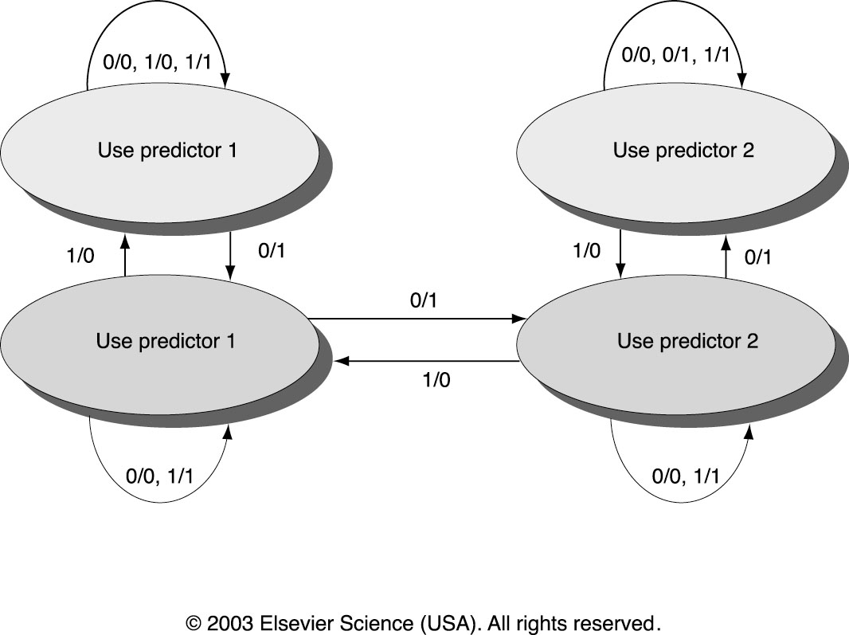
Tournament Predictors
Multilevel branch predictor
Use n-bit saturating counter to choose between predictors
Usual choice between global and local predictors
CS252 S06 Lec7 ILP

Slide 20
Special Case: Return Addresses
Register Indirect branch - hard to predict address. Procedure can be called from many places, hard to remember where to return.
In SPEC programs, 85% such branches for procedure return
Since stack discipline is used for procedures, we can save return address in small buffer that acts like a stack: 8 to 16 entries has small miss rate
It is called RAS – Return Address Stack

Slide 21
Exceptions and Interrupts
§4.9 Exceptions
“Unexpected” events requiring change
in flow of control
  Different ISAs use the terms differently
Exception
  Arises within the CPU
    e.g., undefined opcode, overflow, syscall, …
Interrupt
  From an external I/O controller
Dealing with them without sacrificing performance is hard
Chapter 4 — The Processor — <number>
Notes:
Morgan Kaufmann Publishers
Chapter 4 — The Processor

Slide 22
Handling Exceptions
Save PC of offending (or interrupted) instruction
  In LEGv8: Exception Link Register (ELR)
Save indication of the problem
  In LEGv8: Exception Syndrome Rregister (ESR)
  We’ll assume 1-bit
    0 for undefined opcode, 1 for overflow
Chapter 4 — The Processor — <number>
Notes:
Morgan Kaufmann Publishers
Chapter 4 — The Processor

Slide 23
An Alternate Mechanism
Vectored Interrupts
  Handler address determined by the cause
Exception vector address to be added to a vector table base register:
  Unknown Reason: 00 0000_{two}
  Overflow: 10 1100_{two}
  …: 11 1111_{two}
Instructions either
  Deal with the interrupt, or
  Jump to real handler
Chapter 4 — The Processor — <number>
Notes:
Morgan Kaufmann Publishers
Chapter 4 — The Processor

Slide 24
Handler Actions
Read cause, and transfer to relevant handler
Determine action required
If restartable
  Take corrective action
  use ELR to return to program
Otherwise
  Terminate program
  Report error using ELR, cause, …
Chapter 4 — The Processor — <number>
Notes:
Morgan Kaufmann Publishers
Chapter 4 — The Processor

Slide 25
Exceptions in a Pipeline
Another form of control hazard
Consider overflow on add in EX stage
  ADD X1, X2, X1
  Prevent X1 from being clobbered
  Complete previous instructions
  Flush add and subsequent instructions
  Set ESR and ELR register values
  Transfer control to handler
Similar to mispredicted branch
  Use much of the same hardware
Chapter 4 — The Processor — <number>
Notes:
Morgan Kaufmann Publishers
Chapter 4 — The Processor

Slide 26
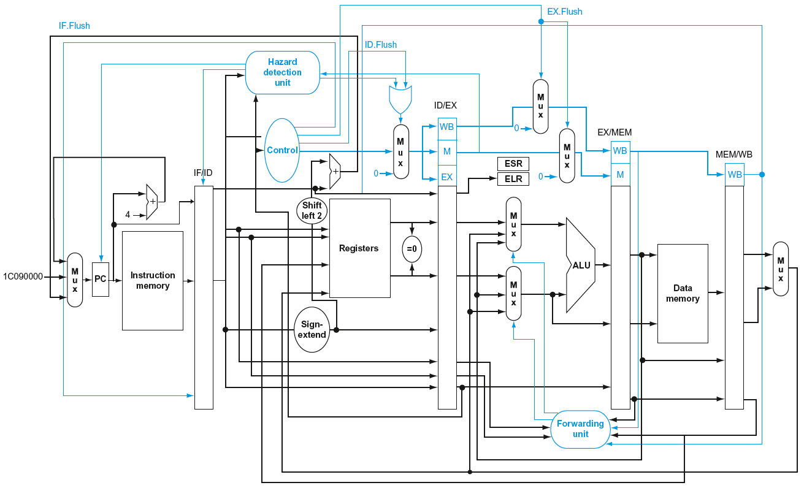
Pipeline with Exceptions
Chapter 4 — The Processor — <number>
Notes:
Morgan Kaufmann Publishers
Chapter 4 — The Processor

Slide 27
Exception Properties
Restartable exceptions
  Pipeline can flush the instruction
  Handler executes, then returns to the instruction
    Refetched and executed from scratch
PC saved in ELR register
  Identifies causing instruction
  Actually PC + 4 is saved
    Handler must adjust
Chapter 4 — The Processor — <number>
Notes:
Morgan Kaufmann Publishers
Chapter 4 — The Processor

Slide 28
Exception Example
Exception on ADD in
  40 SUB X11, X2, X4
  44 AND X12, X2, X5
  48 ORR X13, X2, X6
  4C ADD X1, X2, X1
  50 SUB X15, X6, X7
  54 LDUR X16, [X7,#100]
  …
Handler
  1C090000 STUR X26, [X0,#1000]
  …
Chapter 4 — The Processor — <number>
Notes:
Morgan Kaufmann Publishers
Chapter 4 — The Processor

Slide 29
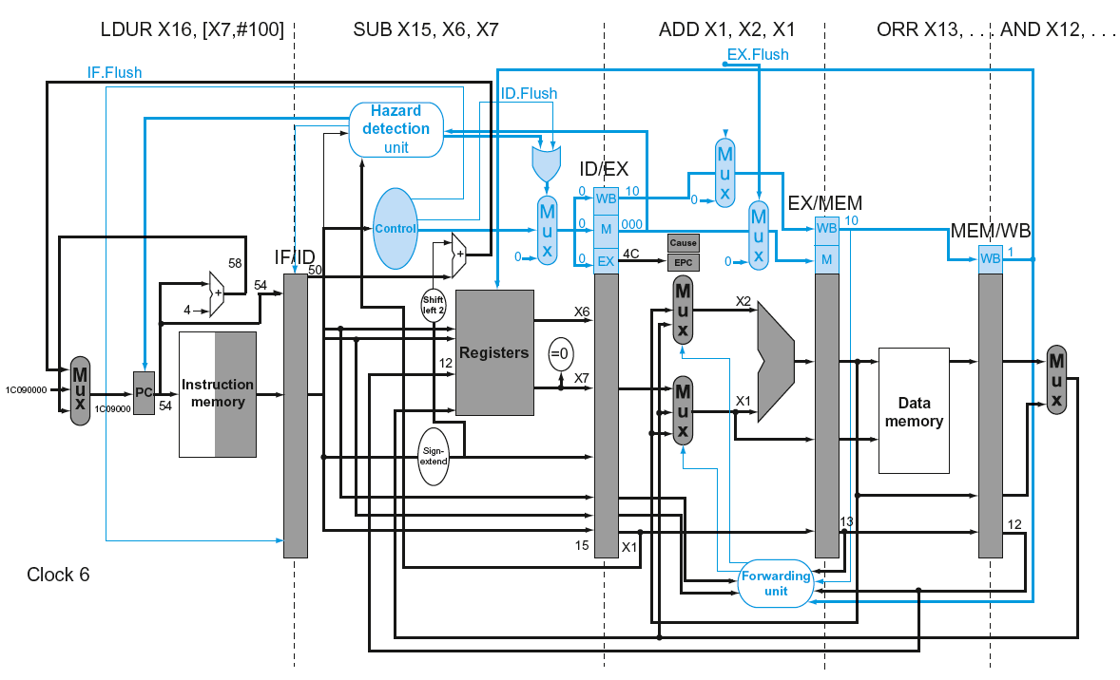
Exception Example
Chapter 4 — The Processor — <number>
Notes:
Morgan Kaufmann Publishers
Chapter 4 — The Processor

Slide 30
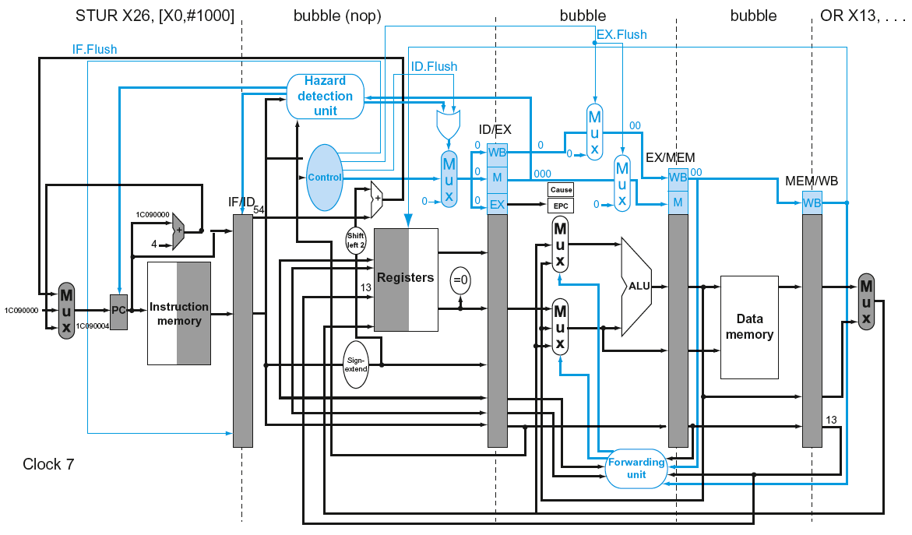
Exception Example
Chapter 4 — The Processor — <number>
Notes:
Morgan Kaufmann Publishers
Chapter 4 — The Processor

Slide 31
Multiple Exceptions
Pipelining overlaps multiple instructions
  Could have multiple exceptions at once
Simple approach: deal with exception from earliest instruction
  Flush subsequent instructions
  “Precise” exceptions
In complex pipelines
  Multiple instructions issued per cycle
  Out-of-order completion
  Maintaining precise exceptions is difficult!
Chapter 4 — The Processor — <number>
Notes:
Morgan Kaufmann Publishers
Chapter 4 — The Processor

Slide 32
Imprecise Exceptions
Just stop pipeline and save state
  Including exception cause(s)
Let the handler work out
  Which instruction(s) had exceptions
  Which to complete or flush
    May require “manual” completion
Simplifies hardware, but more complex handler software
Not feasible for complex multiple-issue
out-of-order pipelines
Chapter 4 — The Processor — <number>
Notes:
Morgan Kaufmann Publishers
Chapter 4 — The Processor

Slide 33
Instruction-Level Parallelism (ILP)
Pipelining: executing multiple instructions in parallel
To increase ILP
  Deeper pipeline
    Less work per stage ⇒ shorter clock cycle
  Multiple issue
    Replicate pipeline stages ⇒ multiple pipelines
    Start multiple instructions per clock cycle
    CPI < 1, so use Instructions Per Cycle (IPC)
    E.g., 4GHz 4-way multiple-issue
      16 BIPS, peak CPI = 0.25, peak IPC = 4
    But dependencies reduce this in practice
§4.10 Parallelism via Instructions
Chapter 4 — The Processor — <number>
Notes:
Morgan Kaufmann Publishers
Chapter 4 — The Processor

Slide 34
Multiple Issue
Static multiple issue
  Compiler groups instructions to be issued together
  Packages them into “issue slots”
  Compiler detects and avoids hazards
Dynamic multiple issue
  CPU examines instruction stream and chooses instructions to issue each cycle
  Compiler can help by reordering instructions
  CPU resolves hazards using advanced techniques at runtime
Chapter 4 — The Processor — <number>
Notes:
Morgan Kaufmann Publishers
Chapter 4 — The Processor

Slide 35
Speculation
“Guess” what to do with an instruction
  Start operation as soon as possible
  Check whether guess was right
    If so, complete the operation
    If not, roll-back and do the right thing
Common to static and dynamic multiple issue
Examples
  Speculate on branch outcome
    Roll back if path taken is different
  Speculate on load
    Roll back if location is updated
Chapter 4 — The Processor — <number>
Notes:
Morgan Kaufmann Publishers
Chapter 4 — The Processor

Slide 36
Static Multiple Issue
Compiler groups instructions into “issue packets”
  Group of instructions that can be issued in a single cycle
  Determined by pipeline resources required
Think of an issue packet as a very long instruction
  Specifies multiple concurrent operations
  ⇒ Very Long Instruction Word (VLIW)
Chapter 4 — The Processor — <number>
Notes:
Morgan Kaufmann Publishers
Chapter 4 — The Processor

Slide 37
Scheduling Static Multiple Issue
Compiler must remove some/all hazards
  Reorder instructions into issue packets
  No dependencies with a packet
  Possibly some dependencies between packets
    Varies between ISAs; compiler must know!
  Pad with nop if necessary
Chapter 4 — The Processor — <number>
Notes:
Morgan Kaufmann Publishers
Chapter 4 — The Processor

Slide 38
LEGv8 with Static Dual Issue
Two-issue packets
  One ALU/branch instruction
  One load/store instruction
  64-bit aligned
    ALU/branch, then load/store
    Pad an unused instruction with nop
Address | Instruction type | Pipeline Stages
n | ALU/branch | IF | ID | EX | MEM | WB
n + 4 | Load/store | IF | ID | EX | MEM | WB
n + 8 | ALU/branch |  | IF | ID | EX | MEM | WB
n + 12 | Load/store |  | IF | ID | EX | MEM | WB
n + 16 | ALU/branch |  |  | IF | ID | EX | MEM | WB
n + 20 | Load/store |  |  | IF | ID | EX | MEM | WB
Chapter 4 — The Processor — <number>
Notes:
Morgan Kaufmann Publishers
Chapter 4 — The Processor

Slide 39
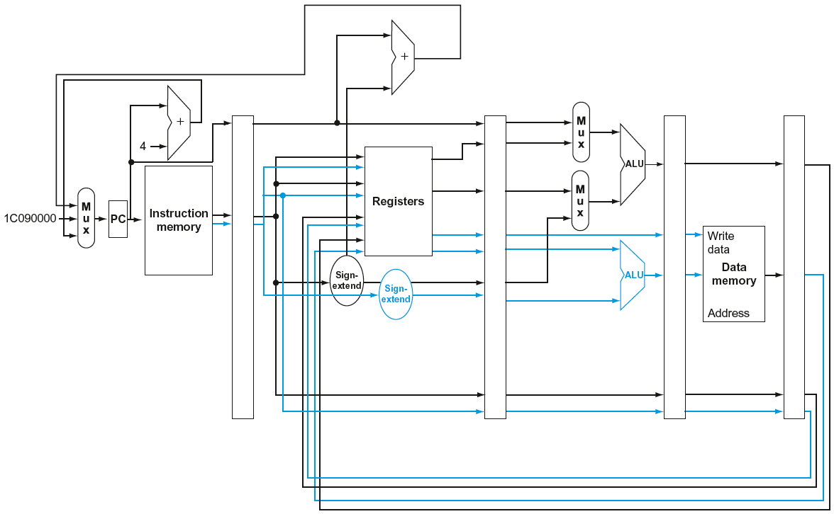
LEGv8 with Static Dual Issue
Chapter 4 — The Processor — <number>
Notes:
Morgan Kaufmann Publishers
Chapter 4 — The Processor

Slide 40
Hazards in the Dual-Issue LEGv8
More instructions executing in parallel
EX data hazard
  Forwarding avoided stalls with single-issue
  Now can’t use ALU result in load/store in same packet
    ADD X0, X0, X1
    LDUR X2, [X0,#0]
    Split into two packets, effectively a stall
Load-use hazard
  Still one cycle use latency, but now two instructions
More aggressive scheduling required
Chapter 4 — The Processor — <number>
Notes:
Morgan Kaufmann Publishers
Chapter 4 — The Processor

Slide 41
Dynamic Multiple Issue
“Superscalar” processors
CPU decides whether to issue 0, 1, 2, … each cycle
  Avoiding structural and data hazards
Avoids the need for compiler scheduling
  Though it may still help
  Code semantics ensured by the CPU
Chapter 4 — The Processor — <number>
Notes:
Morgan Kaufmann Publishers
Chapter 4 — The Processor

Slide 42
Dynamic Pipeline Scheduling
Allow the CPU to execute instructions out of order to avoid stalls
  But commit result to registers in order
Example
  LDUR X0, [X21,#20]
  ADD X1, X0, X2
  SUB X23,X23,X3
  ANDI X5, X23,#20
  Can start sub while ADD is waiting for LDUI
Chapter 4 — The Processor — <number>
Notes:
Morgan Kaufmann Publishers
Chapter 4 — The Processor

Slide 43
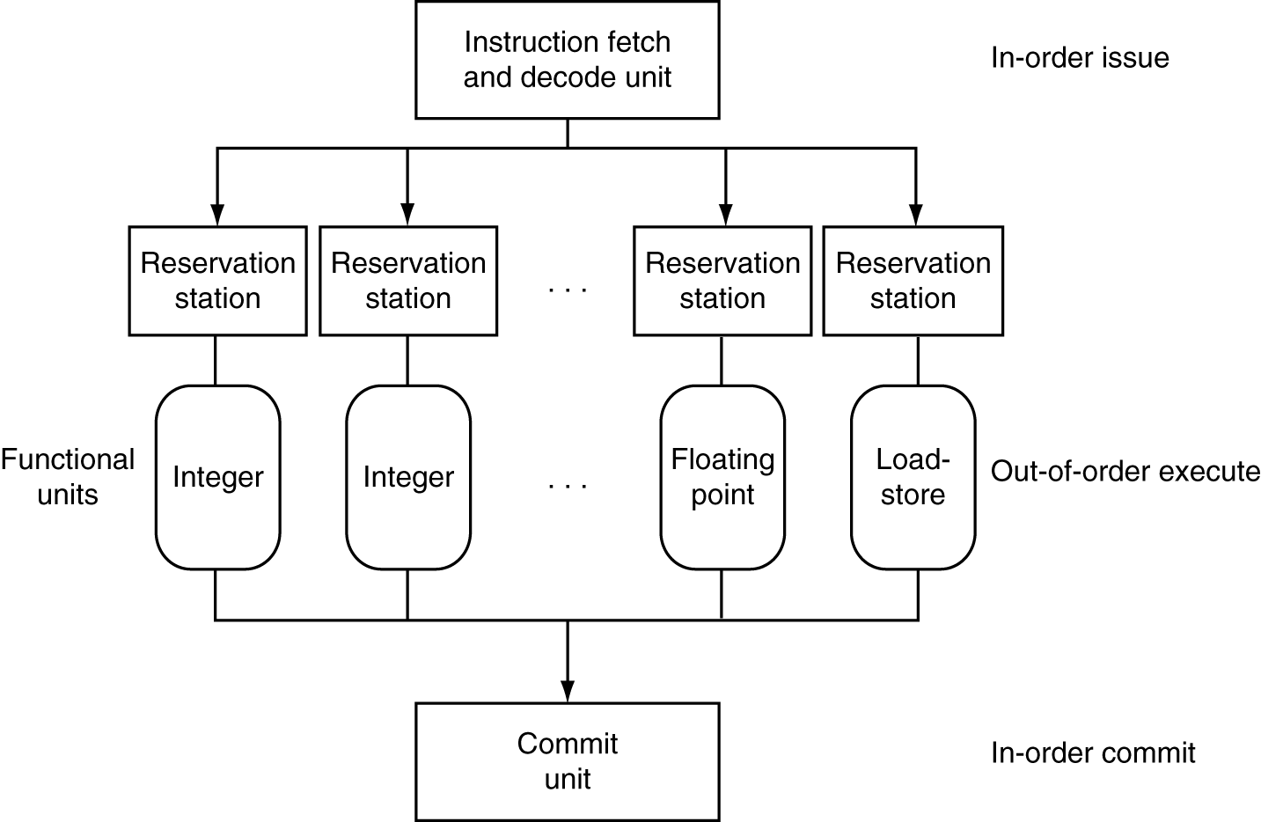
Dynamically Scheduled CPU
Preserves dependencies
Hold pending operands
Results also sent to any waiting reservation stations
Reorders buffer for register writes
Can supply operands for issued instructions
Chapter 4 — The Processor — <number>
Notes:
Morgan Kaufmann Publishers
Chapter 4 — The Processor

Slide 44
Speculation
Predict branch and continue issuing
  Don’t commit until branch outcome determined
Load speculation
  Avoid load and cache miss delay
    Predict the effective address
    Predict loaded value
    Load before completing outstanding stores
    Bypass stored values to load unit
  Don’t commit load until speculation cleared
Chapter 4 — The Processor — <number>
Notes:
Morgan Kaufmann Publishers
Chapter 4 — The Processor

Slide 45
Why Do Dynamic Scheduling?
Why not just let the compiler schedule code?
Not all stalls are predicable
  e.g., cache misses
Can’t always schedule around branches
  Branch outcome is dynamically determined
Different implementations of an ISA have different latencies and hazards
Chapter 4 — The Processor — <number>
Notes:
Morgan Kaufmann Publishers
Chapter 4 — The Processor

Slide 46
Does Multiple Issue Work?
The BIG Picture
Yes, but not as much as we’d like
Programs have real dependencies that limit ILP
Some dependencies are hard to eliminate
  e.g., pointer aliasing
Some parallelism is hard to expose
  Limited window size during instruction issue
Memory delays and limited bandwidth
  Hard to keep pipelines full
Speculation can help if done well
Chapter 4 — The Processor — <number>
Notes:
Morgan Kaufmann Publishers
Chapter 4 — The Processor

Slide 47
Power Efficiency
Complexity of dynamic scheduling and speculations requires power
Multiple simpler cores may be better
Microprocessor | Year | Clock Rate | Pipeline Stages | Issue width | Out-of-order/ Speculation | Cores | Power
i486 | 1989 | 25MHz | 5 | 1 | No | 1 | 5W
Pentium | 1993 | 66MHz | 5 | 2 | No | 1 | 10W
Pentium Pro | 1997 | 200MHz | 10 | 3 | Yes | 1 | 29W
P4 Willamette | 2001 | 2000MHz | 22 | 3 | Yes | 1 | 75W
P4 Prescott | 2004 | 3600MHz | 31 | 3 | Yes | 1 | 103W
Core | 2006 | 2930MHz | 14 | 4 | Yes | 2 | 75W
UltraSparc III | 2003 | 1950MHz | 14 | 4 | No | 1 | 90W
UltraSparc T1 | 2005 | 1200MHz | 6 | 1 | No | 8 | 70W
Chapter 4 — The Processor — <number>
Notes:
Morgan Kaufmann Publishers
Chapter 4 — The Processor

Slide 48
Cortex A53 and Intel i7
Processor | ARM A53 | Intel Core i7 920
Market | Personal Mobile Device | Server, cloud
Thermal design power | 100 milliWatts (1 core @ 1 GHz) | 130 Watts
Clock rate | 1.5 GHz | 2.66 GHz
Cores/Chip | 4 (configurable) | 4
Floating point? | Yes | Yes
Multiple issue? | Dynamic | Dynamic
Peak instructions/clock cycle | 2 | 4
Pipeline stages | 8 | 14
Pipeline schedule | Static in-order | Dynamic out-of-order with speculation
Branch prediction | Hybrid | 2-level
1st level caches/core | 16-64 KiB I, 16-64 KiB D | 32 KiB I, 32 KiB D
2nd level caches/core | 128-2048 KiB | 256 KiB (per core)
3rd level caches (shared) | (platform dependent) | 2-8 MB
§4.11 Real Stuff: The ARM Cortex-A8 and Intel Core i7 Pipelines
Chapter 4 — The Processor — <number>

Slide 49
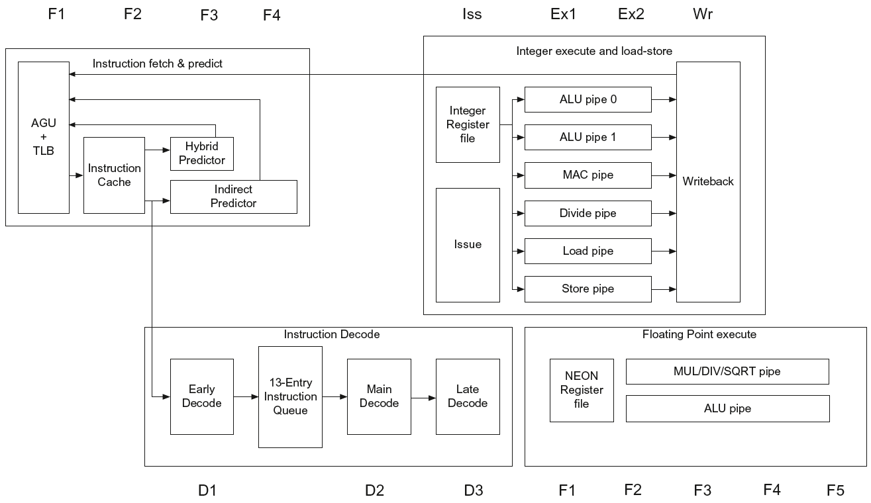
ARM Cortex-A53 Pipeline
Chapter 4 — The Processor — <number>

Slide 50
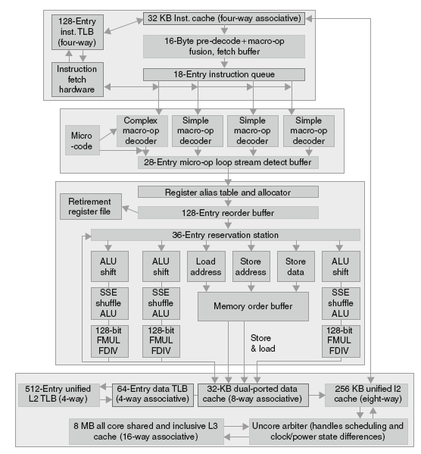
Core i7 Pipeline
Chapter 4 — The Processor — <number>

Slide 51
Fallacies
Pipelining is easy (!)
  The basic idea is easy
  The devil is in the details
    e.g., detecting data hazards
Pipelining is independent of technology
  So why haven’t we always done pipelining?
  More transistors make more advanced techniques feasible
  Pipeline-related ISA design needs to take account of technology trends
    e.g., predicated instructions
§4.14 Fallacies and Pitfalls
Chapter 4 — The Processor — <number>
Notes:
Morgan Kaufmann Publishers
Chapter 4 — The Processor

Slide 52
Pitfalls
Poor ISA design can make pipelining harder
  e.g., complex instruction sets (VAX, IA-32)
    Significant overhead to make pipelining work
    IA-32 micro-op approach
  e.g., complex addressing modes
    Register update side effects, memory indirection
  e.g., delayed branches
    Advanced pipelines have long delay slots
Chapter 4 — The Processor — <number>
Notes:
Morgan Kaufmann Publishers
Chapter 4 — The Processor

Slide 53
Concluding Remarks
ISA influences design of datapath and control
Datapath and control influence design of ISA
Pipelining improves instruction throughput
using parallelism
  More instructions completed per second
  Latency for each instruction not reduced
Hazards: structural, data, control
Multiple issue and dynamic scheduling (ILP)
  Dependencies limit achievable parallelism
  Complexity leads to the power wall
§4.14 Concluding Remarks
Chapter 4 — The Processor — <number>
Notes:
Morgan Kaufmann Publishers
Chapter 4 — The Processor

